Slide 1
UNIT-III
DevOps:
Introduction to DevOps,
why DevOps
DevOps process and continues delivery,
Pipeline,
Release management,
Kanban DevOps Architecture,
DevOps life cycle for business Agility and Continuous testing.

Slide 2
DevOps
DevOps is basically a combination of two words- Development and Operations.
DevOps is a culture that implements the technology in order to promote collaboration between the developer team and the operations team to deploy code to production faster in an automated and repeatable way.
2
1

Slide 3
Why DevOps?
The goal of DevOps is to increase an organization’s speed when it comes to delivering applications and services.
Many companies have successfully implemented DevOps to enhance their user experience including Amazon, Netflix, etc.
Traditional IT has 1000s lines of code and is created by different teams with different standards whereas DevOps is created by one team with intimate knowledge of the product.
Traditional IT is complex to understand and DevOps is easily understandable.
3
1

Slide 4
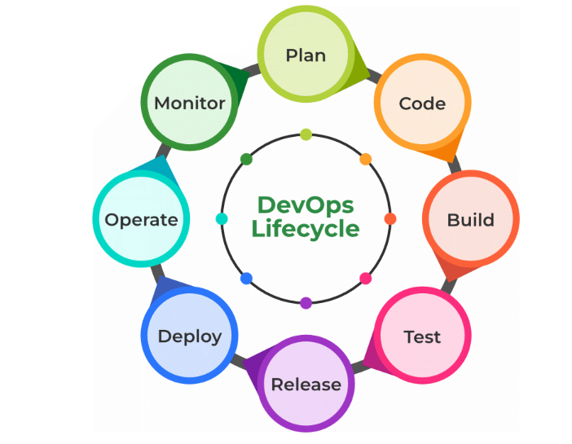
DevOps lifecycle is the methodology where professional development teams come together to bring products to market more efficiently and quickly.
4
1

Slide 5
Plan: Determining the commercial needs and gathering the opinions of end-user by professionals in this level of the DevOps lifecycle.
Code: At this level, the code for the same is developed and in order to simplify the design, the team of developers uses tools and extensions that take care of security problems.
Build: After the coding part, programmers use various tools for the submission of the code to the common code source.
Test: This level is very important to assure software integrity. Various sorts of tests are done such as user acceptability testing, safety testing, speed testing, and many more.

Slide 6
Release: At this level, everything is ready to be deployed in the operational environment.
Deploy: In this level, Infrastructure-as-Code assists in creating the operational infrastructure and subsequently publishes the build using various DevOps lifecycle tools.
Operate: At this level, the available version is ready for users to use. Here, the department looks after the server configuration and deployment.
Monitor: The observation is done at this level that depends on the data which is gathered from consumer behavior, the efficiency of applications, and from various other sources.

Slide 7
Advantages
Faster Delivery: DevOps enables organizations to release new products and updates faster and more frequently, which can lead to a competitive advantage.
Improved Collaboration: DevOps promotes collaboration between development and operations teams, resulting in better communication, increased efficiency, and reduced friction.
Improved Quality: DevOps emphasizes automated testing and continuous integration, which helps to catch bugs early in the development process and improve the overall quality of software.
Increased Automation: DevOps enables organizations to automate many manual processes, freeing up time for more strategic work and reducing the risk of human error.

Slide 8
Better Scalability: DevOps enables organizations to quickly and efficiently scale their infrastructure to meet changing demands, improving the ability to respond to business needs.
Increased Customer Satisfaction: DevOps helps organizations to deliver new features and updates more quickly, which can result in increased customer satisfaction and loyalty.
Improved Security: DevOps promotes security best practices, such as continuous testing and monitoring, which can help to reduce the risk of security breaches and improve the overall security of an organization’s systems.
Better Resource Utilization: DevOps enables organizations to optimize their use of resources, including hardware, software, and personnel, which can result in cost savings and improved efficiency.

Slide 9
Disadvantages
High Initial Investment: Implementing DevOps can be a complex and costly process, requiring significant investment in technology, infrastructure, and personnel.
Skills Shortage: Finding qualified DevOps professionals can be a challenge, and organizations may need to invest in training and development programs to build the necessary skills within their teams.
Resistance to Change: Some employees may resist the cultural and organizational changes required for successful DevOps adoption, which can result in resistance, resistance to collaboration, and reduced efficiency.

Slide 10
Lack of Standardization: DevOps is still a relatively new field, and there is a lack of standardization in terms of methodologies, tools, and processes. This can make it difficult for organizations to determine the best approach for their specific needs.
Increased Complexity: DevOps can increase the complexity of software delivery, requiring organizations to manage a larger number of moving parts and integrate multiple systems and tools.
Dependency on Technology: DevOps relies heavily on technology, and organizations may need to invest in a variety of tools and platforms to support the DevOps process.
Need for Continuous Improvement: DevOps requires ongoing improvement and adaptation, as new technologies and best practices emerge. Organizations must be prepared to continuously adapt and evolve their DevOps practices to remain competitive.

Slide 11
Version control systems
Version control systems are a category of software tools that helps in recording changes made to files by keeping a track of modifications done in the code.
For each different contributor to the project, a different working copy is maintained and not merged to the main file unless the working copy is validated. The most popular example is Git, Helix core, Microsoft TFS.
Merge in Git allows you to join two or more development work created using git branch into a single branch. It incorporates the changes from named commits and diverges them into the current branch.
Before making a merge option make sure the receiving branch and the merging branch are up-to-date with the latest remote changes.

Slide 12
Git
Git has always been the first preference and is the most popular version control system among developers for years. That’s the reason developers choose this blindfolded.
Git is the open-source version control system that has the most reliable workflow and helps the software team to collaborate and manage the changes made in the code.
If an error is made, you can also undo errors and go back to the previous versions. Since Git is free, many developers and engineers use the tool, and is a great fit for organizations.
Features:
Cross-platform
Amazing command line utility, known as git bash
Compatible with HTTP, FTP, and SSH
Free and has distributed repository model

Slide 13
Merge Strategies in Git
Git provides various methods to merge different commits into a base commit. These methods are called Merge Strategies. These base commits are combined to form merge commits.
A merge commit is just like the regular commit except that it has two parent commits. Out of multiple strategies for the merging process, the git will automatically choose one if not specified explicitly.
This automatic selection of the merge strategy is based on the branches provided for merging. There are various types of merge strategies
Fast Forward
Recursive
Ours
Octopus
Resolve
Subtree

Slide 14
DevOps process and continues delivery
CI And CD is the practice of automating the integration of code changes from multiple developers into a single codebase. It is a software development practice where the developers commit their work frequently to the central code repository (Github or Stash).
The key goals of Continuous Integration are to find and address bugs quicker, make the process of integrating code across a team of developers easier, improve software quality, and reduce the time it takes to release new feature updates. Some popular CI tools are Jenkins, TeamCity, and Bamboo.

Slide 15
Continuous Integration
With Continuous Integration, developers frequently commit to a shared common repository using a version control system such as Git.
A continuous integration pipeline can automatically run builds, store the artifacts, run unit tests, and even conduct code reviews using tools like Sonar. We can configure the CI pipeline to be triggered every time there is a commit/merge in the codebase.
Continuous Delivery
Continuous Delivery automates the entire software release process. The final decision to deploy to a live production environment can be triggered by the developer/project lead as required. Some popular CD tools are AWS CodeDeploy, Jenkins, and GitLab.
If Continuous Delivery is implemented properly, we will always have a deployment-ready code that has passed through a standardized test process.

Slide 16
Continuous integration vs. continuous delivery vs. continuous deployment
These three terminologies—continuous integration, delivery, and deployment —indicate evolving maturity in software development practices in that order.
Continuous integration, the first step needed for this practice to work, refers to integrating individual code with the overall development environment after building and testing it. Tools like Jenkins ensure that the code is compiled, run, and tested before it's integrated with the rest.
Continuous delivery is the layer that sits on top of continuous integration. Continuous delivery, which only works if continuous integration is in place, involves running extensive regression, UI, and performance tests to ensure that the code is production-ready.

Slide 17
Continuous deployment takes the model a step further by automatically deploying code to production after each code commits and builds.
While in continuous delivery, the deployment pipeline follows an on-demand model; it is pushed automatically every time. This can only work in highly mature DevOps teams.
The so-called CICD pipeline (continuous integration/continuous deployment) is a practice focused on improving software delivery throughout the software development life cycle via deployment automation.

Slide 18
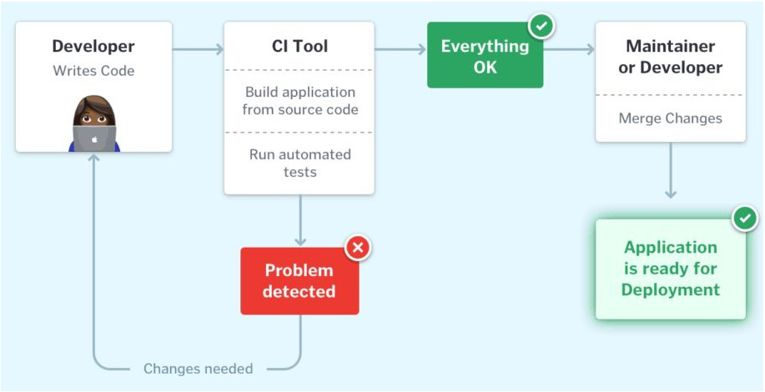
CI pipeline– the workflow from developers checking in their code to its automated build, test, and final notification of the build status.

Slide 19
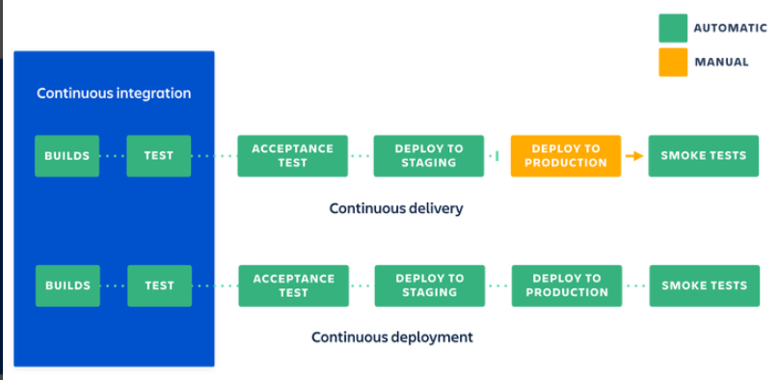
Continuous Integration combined with Continuous Delivery helps quicken the software delivery process with lower risks and improved quality.

Slide 20
DevOps pipeline
A DevOps pipeline combines processes, tooling, and automation to enable organizations and software teams to build, test, and deliver high-quality software quickly to end users.
A DevOps pipeline is a combination of automation, tools, and practices across the SDLC to facilitate the development and deployment of software into the hands of end users.
Critically, there is no one-size-fits-all approach to building a DevOps pipeline and they often vary in design and implementation from one organization to another.
Most DevOps pipelines, however, involve automation, continuous integration and continuous deployment (CI/CD), automated testing, reporting, and monitoring.

Slide 21
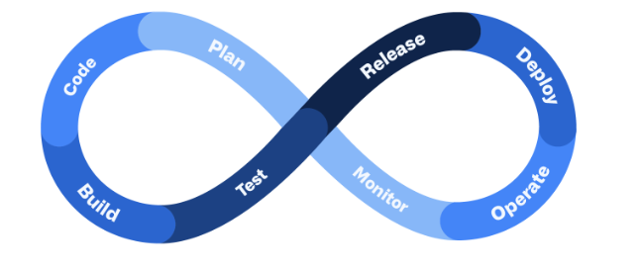
Benefits of a DevOps pipeline
Faster software delivery
More reliable and higher-quality software
Reduced risk
Automation reduces the need for manual efforts
Shorter review times (and faster resolution times)

Slide 22
Release management
Release management in DevOps refers to the comprehensive set of practices and processes involved in planning, scheduling, coordinating, and controlling the release of software applications or updates.
It aims to minimize risk, ensure quality, and maximize the value of software releases to end-users or customers.
In the world of software development, release management plays a pivotal role in ensuring the smooth and efficient delivery of software products.
It serves as a bridge between the development and operations teams, allowing for effective collaboration and coordination throughout the software development lifecycle.

Slide 23
Key Components of Release Management
1. Planning and Coordination- identifying the scope of a release, defining its objectives, and establishing a timeline for its delivery.
2. Environment Management- requires the establishment and maintenance of consistent and reliable environments for development, testing, and production.
3. Release Deployment- The deployment phase of release management involves the actual installation, configuration, and activation of the software release on target environments.

Slide 24
4. Testing and Quality Assurance- conducting various types of testing, including unit testing, integration testing, regression testing, and user acceptance testing, to validate the functionality, performance, and security of the software release.
5. Change Management- it involves assessing and managing the impact of changes introduced in a release. This includes evaluating potential risks, communicating with stakeholders, and implementing strategies to minimize disruption and ensure a smooth transition.
6. Release Monitoring and Feedback- Monitoring the performance and stability of a released software application is crucial for identifying and addressing any issues or bugs. Gathering feedback from end-users and stakeholders helps to continuously improve the software and enhance future releases.

Slide 25
Benefits of Effective Release Management
Efficient Deployment and Rollback
Improved Quality Assurance
Enhanced Collaboration and Communication
Increased Stability and Reliability
Risk Mitigation and Compliance
Continuous Improvement and Feedback Loop

Slide 26
Stages In DevOps Release Management
Planning and Requirements Gathering
Development and Testing
Continuous Integration and Deployment
Release Planning and Coordination
Release Deployment
Monitoring and Feedback

Slide 27
Best Practices for DevOps Release Management
Establish Continuous Integration and Deployment
Implement Version Control
Define and Automate Release Pipelines
Use Infrastructure as Code (IaC)
Employ Continuous Monitoring and Feedback Loops
Conduct Testing at Every Stage
Facilitate Collaboration and Communication
Implement Change Management Processes

Slide 28
Kanban DevOps Architecture
A major subtype of Agile Development is the Kanban methodology which emphasizes visualizing the entire product development on boards.
Kanban Methodology
Kanban(Kan-sign,ban-board) is one of the widely used software development methodologies along with Scrum. The Kanban Methodology was developed in the 1940s by Toyota for manufacturing purposes.
Kanban is a development framework that involves the use of a Kanban Board to visualize the workflow of the entire project.
A Kanban board is nothing but a work board that is divided into several columns. The individual columns represent the workflow phases of the project. The set of these phases are – To-Do, In-Progress, Validation, and completed.

Slide 29
Kanban Workflow
To-Do: The workflow is started with an empty clear board where all the tasks are meant to be listed. The individual cards must provide a brief description and necessary details of tasks like due date, functionalities, nature of task, etc.
In-Progress: It acts as an indication that a team is currently operating working on it.
Validation: the code is reviewed, and the model is tested against several sets of tests like unit testing, acceptance testing, system testing, etc.
Done: The done column reflects all the tasks that are finished and deployed without any errors.

Slide 30
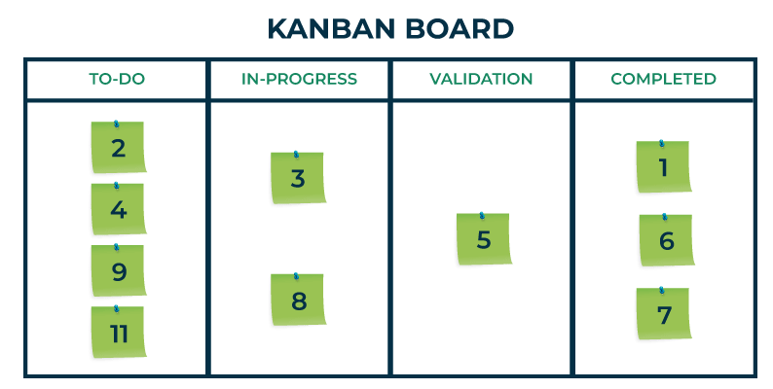

Slide 31
Kanban Principles
Kanban methodology is based on Lean Development approach. Every single product being developed using the Kanban methodology must adhere to some set of key principles and guidelines.
Start with the existing process
Agree to continue evolutionary and incremental changes
Admire current roles, processes, responsibilities & titles
Leadership at all levels

Slide 32
DevOps life cycle
7 Cs of DevOps
Continuous Development
Continuous Integration
Continuous Testing
Continuous Deployment/Continuous Delivery
Continuous Monitoring
Continuous Feedback
Continuous Operations

Slide 33
Business Agility
Business agility refers to an organization’s ability to adapt, respond, and thrive in a rapidly changing business environment. It involves being flexible, innovative, and capable of making quick decisions to seize opportunities or mitigate risks.
Key Aspects
Adaptive Strategy: Organizations need to develop strategies that can evolve based on market dynamics, customer needs, and technological advancements.
Agile Practices: Implementing agile methodologies (such as Scrum, Kanban, or SAFe) allows teams to collaborate, iterate, and deliver value incrementally.
Cross-Functional Teams: Encouraging collaboration across different functions (development, marketing, operations) fosters agility.
Customer-Centric Approach: Prioritizing customer feedback and adjusting products/services accordingly.
Lean Thinking: Eliminating waste, optimizing processes, and focusing on value delivery.

Slide 34
Benefits:
Faster time-to-market
Improved customer satisfaction
Better risk management
Enhanced innovation

Slide 35
Continuous Testing
Continuous testing is an integral part of the software development
lifecycle (SDLC) where testing activities occur continuously
throughout the development process.
Key Aspects:
Automation: Leveraging test automation tools to execute tests frequently and consistently.
Shift-Left Testing: Moving testing activities earlier in the SDLC to catch defects sooner.
Integration with CI/CD: Integrating testing into the continuous integration and continuous deployment pipelines.
Test Data Management: Ensuring availability of relevant test data for various scenarios.
Performance Testing: Continuously assessing system performance under different loads.

Slide 36
Benefits
Early defect detection
Faster feedback loops
Reduced regression issues
Increased confidence in software quality

